Slide 1






Digital Technique
ECE-2111
Topic : Clock signal, Latch, Flip Flop (FF)
Name: Promit Biswas
Roll:1810039, ECE’18
Date:22-December-2020

Slide 2

Outline
Definition of Clock Signal & Types
Flip-Flop (FF)
Latch
Difference of Flip-Flop & Latch
Example of FF& Latch

Slide 3
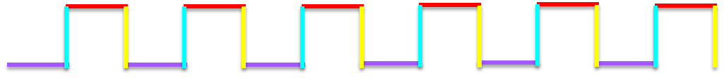
Clock Signal
1
Positive
0
Negative
A clock signal is produced by a clock generator and it is used to control the operation of any sequential circuit.
A clock signal is produced by a clock generator and it is used to control the operation of any sequential circuit.
There are two parts of a clock pulse
I. Two Levels (0 and 1)
II. Two Edges (Positive and Negative)
Types of Clock pulse
I. Level Clocking
II. Edge triggering

Slide 4
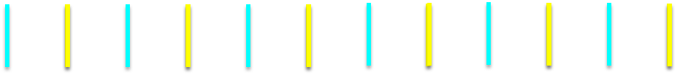
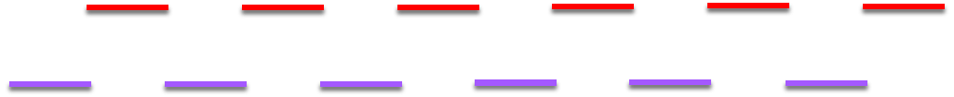
Flip-Flop
In Flip-flop “Edge Triggering” clock pulse is used to control the operation of a Flip-Flop.
Latch
In Latch “Level Clocking” or “No Clock pulse” is used to control the operation of a Latch.

Slide 5
Flip-Flop & Latch
Flip-Flop
Latch
1. Flip-Flop is edge triggered, so it changes states when a control signal is High to Low or Low to High.
1. Latch is Level triggered, outputs can change as soon as the input changes .
2. A Flip-Flop always have a clock signal.
2. A Latch doesn’t have always a clock signal.
2. It checks the inputs but changes the output only at times defined by the clock signal or any other control signal..
3. It checks the inputs continuously and responds to the changes in inputs immediately.

Slide 6
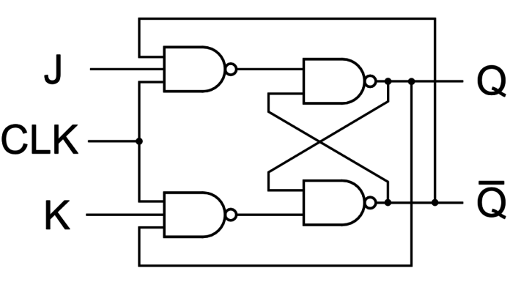
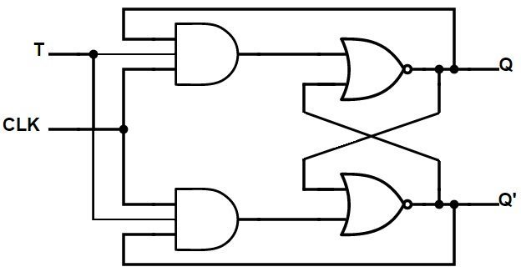
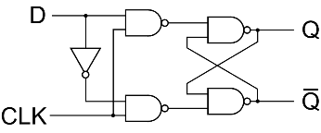
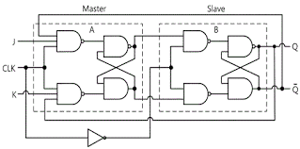
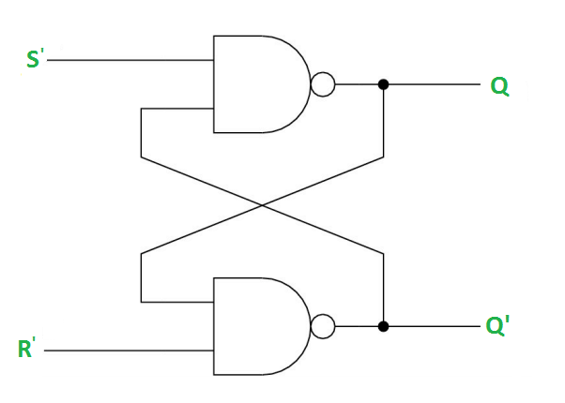
Examples of Flip-Flop
_
Q
J-K Flip-Flop
T Flip-Flop
D Flip-Flop
J-K Master Slave Flip-Flop
Examples of Latch
S
Q
D
_
_
Q
_
Q
R
RS Latch
D Latch
Clocked D Latch

Slide 7
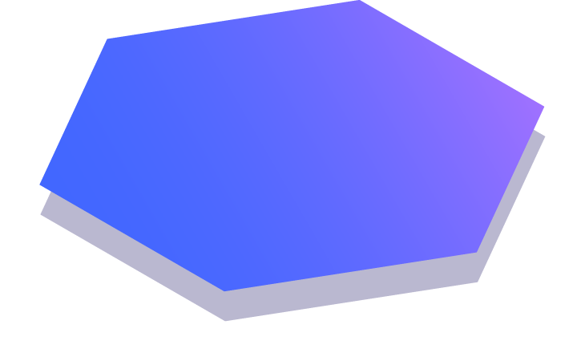
Thanks!
Any questions?

